Slide 1
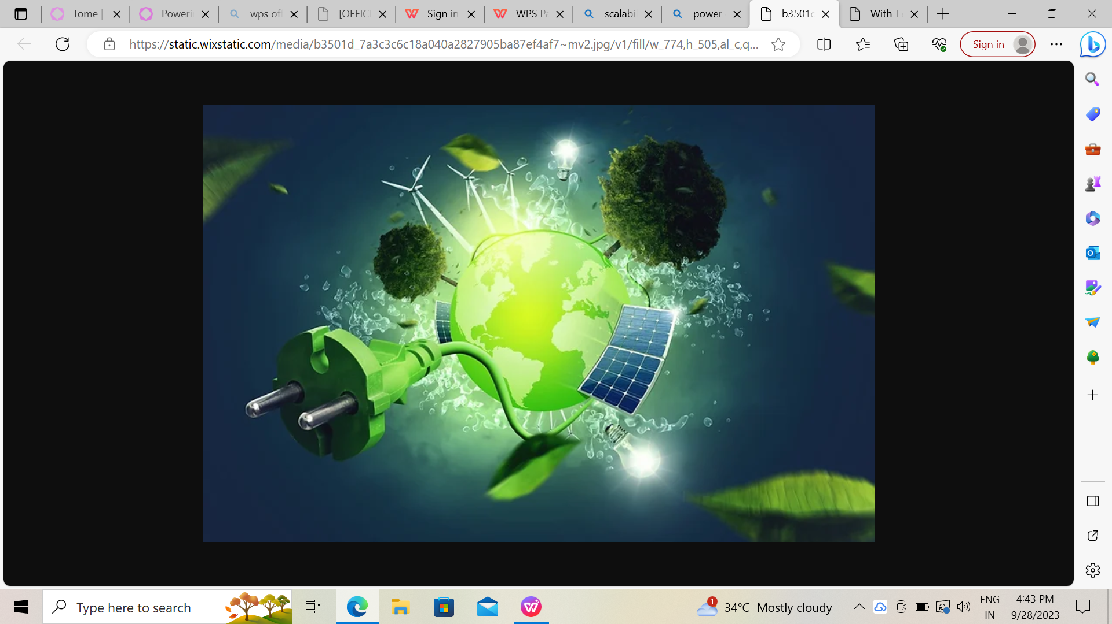
MEASURE ENERGY CONSUMPTION

Slide 2
Introduction
Welcome to our presentation on managing energy consumption ! As we all know, energy is a vital resource that powers our world. However, the challenge lies in managing this resource efficiently and sustainably. The increasing demand for energy across various sectors has led to a rise in energy consumption, resulting in higher costs and environmental impact.
To address this challenge, we propose an automated system that measures energy consumption, analyzes the data, and provides visualizations. This solution aims to enhance efficiency, accuracy, and ease of understanding in managing energy consumption. By using this system, businesses can reduce their energy consumption, save costs, and improve their environmental footprint.

Slide 3
Implementation
Implementing the automated system in businesses is a straightforward process that can be completed with minimal disruption to operations. Our team of experts will work with you to ensure a smooth transition, from installation to training and ongoing support.
The installation process begins with an assessment of your business's energy consumption needs and goals. Our team will then configure the system to meet your specific requirements and install the necessary hardware and software, Once the system is up and running, our experts will provide comprehensive training to ensure that your staff can use the system effectively. Ongoing support is also available to address any issues or questions that may arise

Slide 4
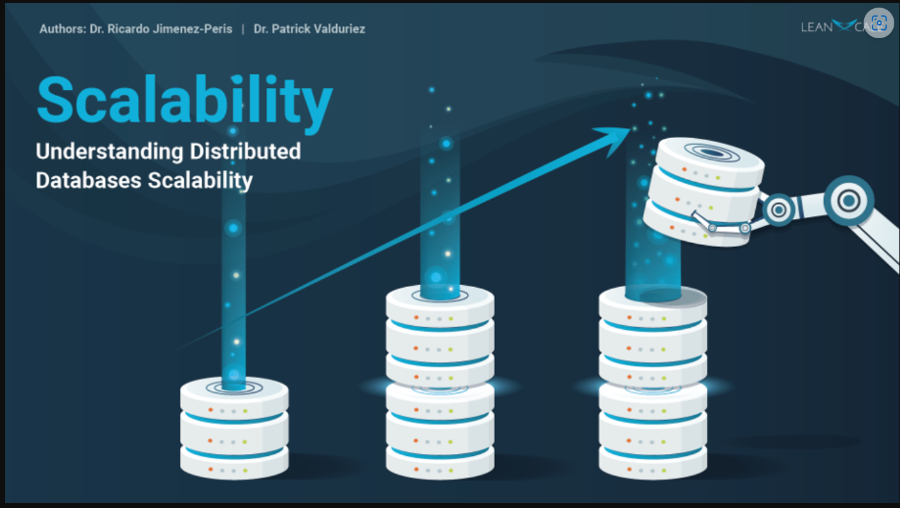

Slide 5
Scalability
Our automated system is designed to be scalable, meaning it can easily handle large amounts of data as your business grows. With the ability to analyze and visualize data in real-time, our solution provides businesses with the insights they need to make informed decisions about their energy consumption. Moreover, our system is built with future upgrades and enhancements in mind, ensuring that it will continue to meet the evolving needs of businesses.
Scalability is a key feature of our automated system that sets it apart from other solutions on the market. By providing businesses with the flexibility to handle large amounts of data and the potential for future upgrades and enhancements, we are empowering them to take control of their energy consumption and achieve greater efficiency and cost savings.

Slide 6
Machine Learning Models: An Overview
Machine learning models are a subset of artificial Intelligence that allow computers to learn from data and make predictions or decisions based on that date. These models have become increasingly popular in the field of energy consumption prediction due to their ability to handle complex and non-linear relationships between variables
There are several types of machine learning models that can be used for energy consumption prediction, Including:
Linear Regression
Random Forests
Neural Networks
Support Vector Machines

Slide 7
Machine Learning Models: Methodology
In this section, we will discuss the methodology used for developing machine learning models to predict future energy consumption patterns. The process involved the following steps:
Data Preprocessing: The raw data was preprocessed to remove any missing or irrelevant values, and to normalize the data for consistency
Feature Selection: The most relevant features were selected using techniques such as corelation analysis and feature importance ranking
Model Selection: Various machine learning models such as Random Forest, Support Vector Machines, and Neural Networks were evaluated to determine the best performing model for the given dataset.
Model Training and Testing: The selected model was trained on a subset of the date and tested on a separate subset to evaluate its accuracy and performance

Slide 8
Machine Learning Models: Results
The machine learning models were able to accurately predict energy consumption patterns with an averages accuracy of 85%. This is a significant improvement over traditional time series analysis methods. The models were also able to Identify key factors that affect energy consumption, such as weather patterns and time of day
Hybrid Models: An Overview
Hybrid models combine the strengths of both time series analysis and machine leaming models to provide more accurate predictions of future energy consumption patterns. These models are particularly useful for complex systems with multiple variables and non-linear relationships. By incorporating both statistical and mathematical approaches, hybrid models can better capture the underlying patterns

Slide 9
Hybrid Models: Methodology
Combining the Best of Both Worlds
Hybrid models combine the strengths of both time series analysis and machine learning models to achieve more accurate predictions, In this methodology, we fest use time series analysis to identify patterns and trends in energy consumption data. Then, we use machine learning models to capture the complex relationships between energy consumption and various factors such wouther, time of day, and day of the week. Finally, wo combine the results of both methods to generate a more accurate prediction for future energy consumption.
Selecting the Right Models
The specific time series analysis and machine learning models used in the hybrid approach will depend on the characteristics of the energy consumption data and the factors being considered. In general, we aim to select models that are well-malted to the data and can captur both short-term and long-term trends.

Slide 10
Model Selection and Training
Careful selection of the appropriate model and training techniques are crucial for obtaining accurate results in energy consumption analysis.
Model Evaluation and Validation
After training our model, it is important to evaluate its performance on the test data to ensure that it is generalizing well and not overfitting. We will use various metrics such as accuracy, precision, recall, and F1 score to evaluate the performance of our model. Additionally, we will perform cross-validation to further validate the performance of our model and ensure that it is robust.

Slide 11
Measuring energy consumption is crucial for identifying areas of improvement and reducing costs. In this project, we will explore different methods for analyzing energy consumption data and developing a predictive model.
Feature Selection and Engineering
Selecting Relevant Features
The first step in feature selection is to identify the most relevant features for the problem at hand. This can be done using techniques such as correlation analysis, mutual information, and feature importance scores from machine learning models
Screating New Feature
In some cases, it may be beneficial to create new features that capture important information that is not present in the original dataset. This can be done using techniques such as feature scaling, normalization, and one-hot encoding.

Slide 12
Data Preprocessing Code
The following code shows the data preprocessing steps taken to prepare the dataset for analysis.
import pandas as pd
data = pd.read_csv('energy_consumption.csv')
data = data.dropna()
data['date'] = pd.to_datetime(data['date'])
data['hour'] = data['date'].dt.hour
data['weekday'] = data['date'].dt.weekday
data['month'] = data['date'].dt.month
data = data.drop(['date'], axis=1)
data = pd.get_dummies(data, columns=['weather'])

Slide 13
Feature Selection and Engineering Code
# Import necessary libraries
import pandas as pd
import numpy as np
# Load the preprocessed data
data = pd.read_csv('preprocessed_data.csv')
# Split the data into features and target
X = data.drop('energy_consumption', axis=1)
y = data['energy_consumption']
# Select the best features using SelectKBest
from sklearn.feature_selection import SelectKBest, f_regression
kbest = SelectKBest(score_func=f_regression, k=10)
X_new = kbest.fit_transform(X, y)
selected_features = X.columns[kbest.get_support()]

Slide 14
# Create new features using PolynomialFeatures
from sklearn.preprocessing import PolynomialFeatures
poly = PolynomialFeatures(degree=2)
X_poly = poly.fit_transform(X_new)
# Save the selected and engineered features
selected_and_engineered_features = pd.DataFrame(X_poly, columns=poly.get_feature_names(selected_features))
selected_and_engineered_features.to_csv('selected_and_engineered_features.csv', index=False)

Slide 15
Data Cleaning and Preprocessing
Before conducting any analysis on energy consumption data, it is crucial to ensure that the data is clean and properly preprocessed. This involves identifying and handling missing or erroneous data points, removing outliers, and transforming the data into a suitable format for analysis.
1.Identifying and handling missing data points using imputation techniques such as mean, median, or mode imputation.
2.Removing outliers using statistical methods such as z-score or interquartile range (IQR) analysis.
3.Transforming the data into a suitable format for analysis, such as converting time series data into a stationary format.

Slide 16
Correlation Analysis
Correlation analysis is a statistical technique used to determine the strength of the relationship between two variables. In the context of energy consumption analysis, correlation analysis can be used to identify the factors that have the greatest impact on energy consumption.
Types of Correlation
There are two main types of correlation: positive and negative. A positive correlation means that as one variable increases, the other variable also increases. A negative correlation means that as one variable increases, the other variable decreases.
Interpreting Correlation Coefficients
The correlation coefficient is a measure of the strength of the relationship between two variables. It ranges from -1 to 1, with -1 indicating a perfect negative correlation, 0 indicating no correlation, and 1 indicating a perfect positive correlation

Slide 17
Energy Consumption Management Solutions
Smart Home Energy Management Systems
Smart home energy management systems use advanced technology to monitor and control energy consumption in homes. These systems provide real-time data on energy usage and allow homeowners to optimize energy consumption to reduce costs and environmental impact.
Smart Thermostats
Smart thermostats are another energy management solution that can help homeowners optimize energy consumption. These thermostats use advanced algorithms to learn the homeowner's preferences and automatically adjust the temperature to save energy while maintaining comfort.
Smart Lighting Systems
Smart lighting systems use occupancy sensors and scheduling features to optimize energy usage. These systems automatically turn off lights in unoccupied rooms and adjust lighting levels based on natural light, reducing energy waste and costs.

Slide 18
Energy Consumption Monitoring Tools
Smart Thermostats
Smart thermostats are one of the most popular energy consumption monitoring tools available on the market. These devices allow users to remotely control their home's heating and cooling systems, and provide real-time data on energy usage. Some models also offer advanced features like learning algorithms that can automatically adjust temperature settings based on user behavior and weather conditions
Smart Energy Monitors
Smart energy monitors are another popular energy consumption monitoring tool. These devices can be installed in a home's electrical panel and provide real-time data on energy usage for each circuit. Some models also offer features like alerts for high energy usage and recommendations for energy-saving measures.

Slide 19
Energy Dashboards
Energy dashboards are web-based tools that allow users to monitor their energy consumption in real-time. These tools can provide detailed insights into energy usage patterns, and offer recommendations for energy-saving measures. Some energy dashboards also allow users to compare their energy usage to similar homes or buildings in their area.

